Slide 1
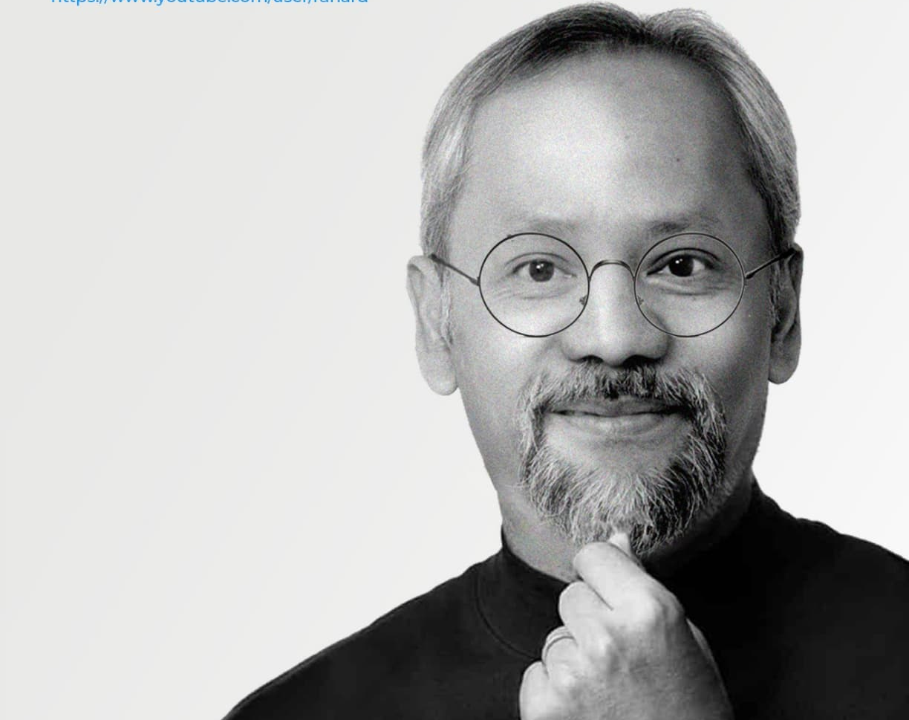
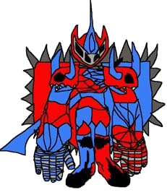
Internet of Things (IoT)
Budi Rahardjo
2023

Slide 2
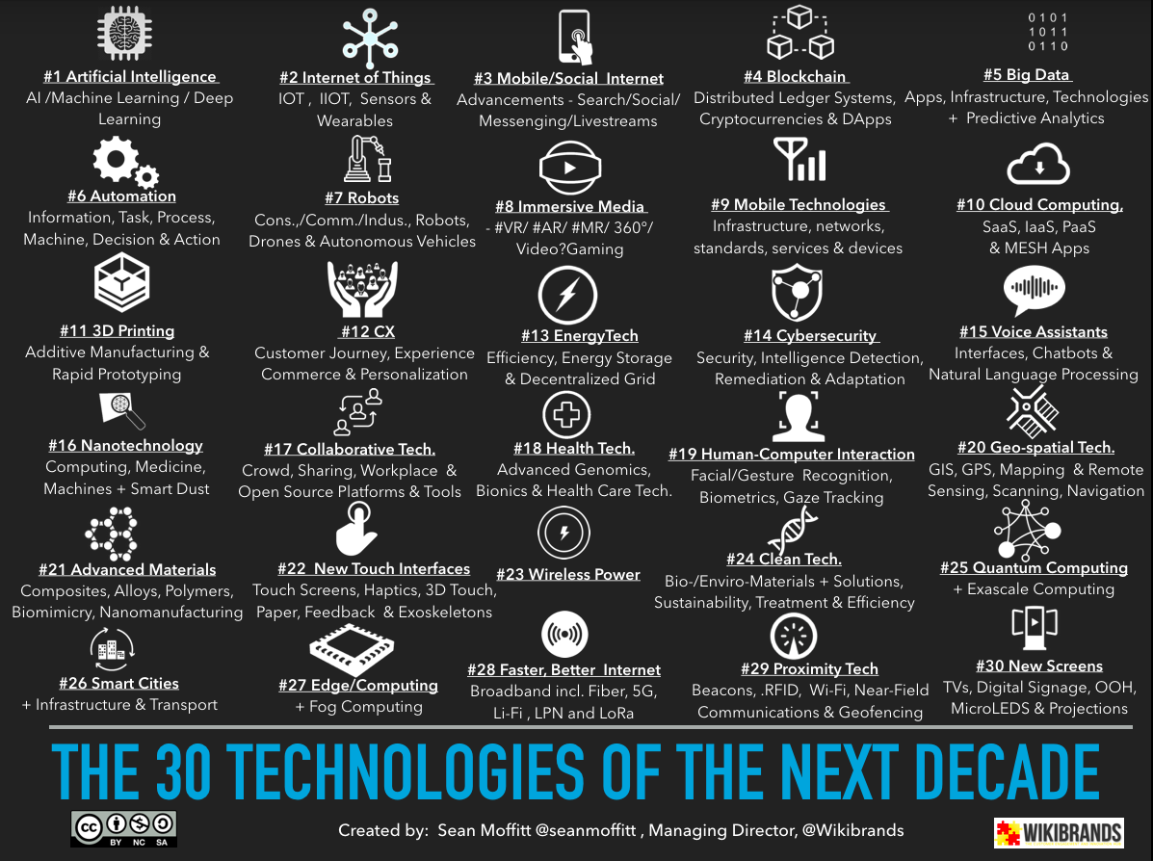

Slide 3
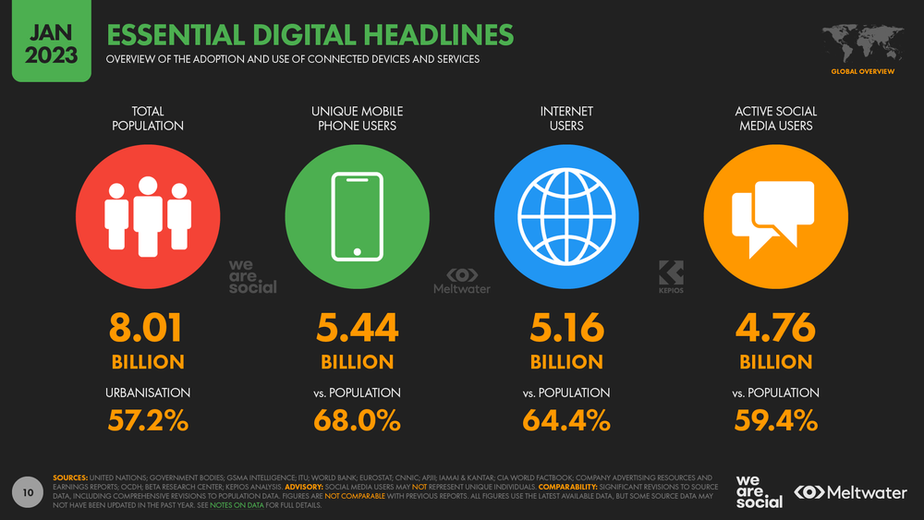

Slide 4
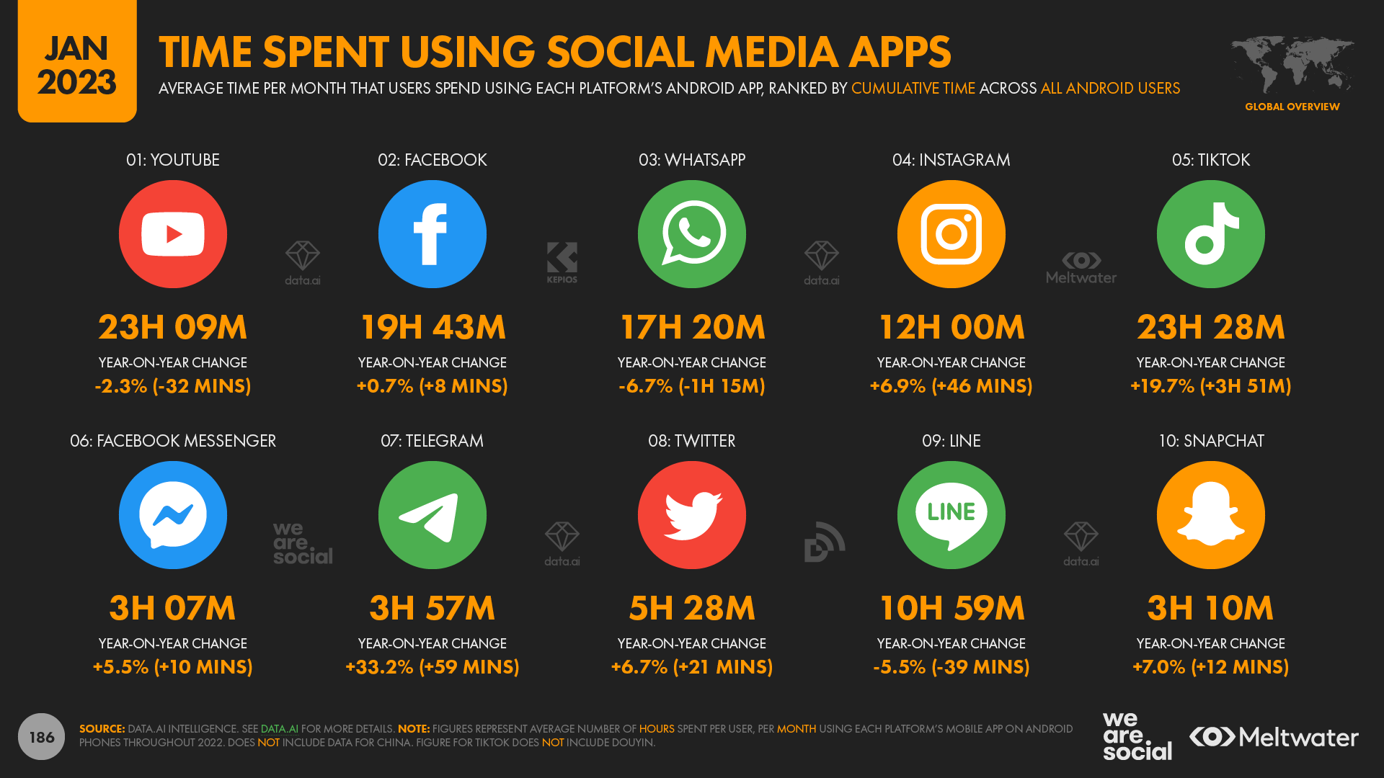

Slide 5
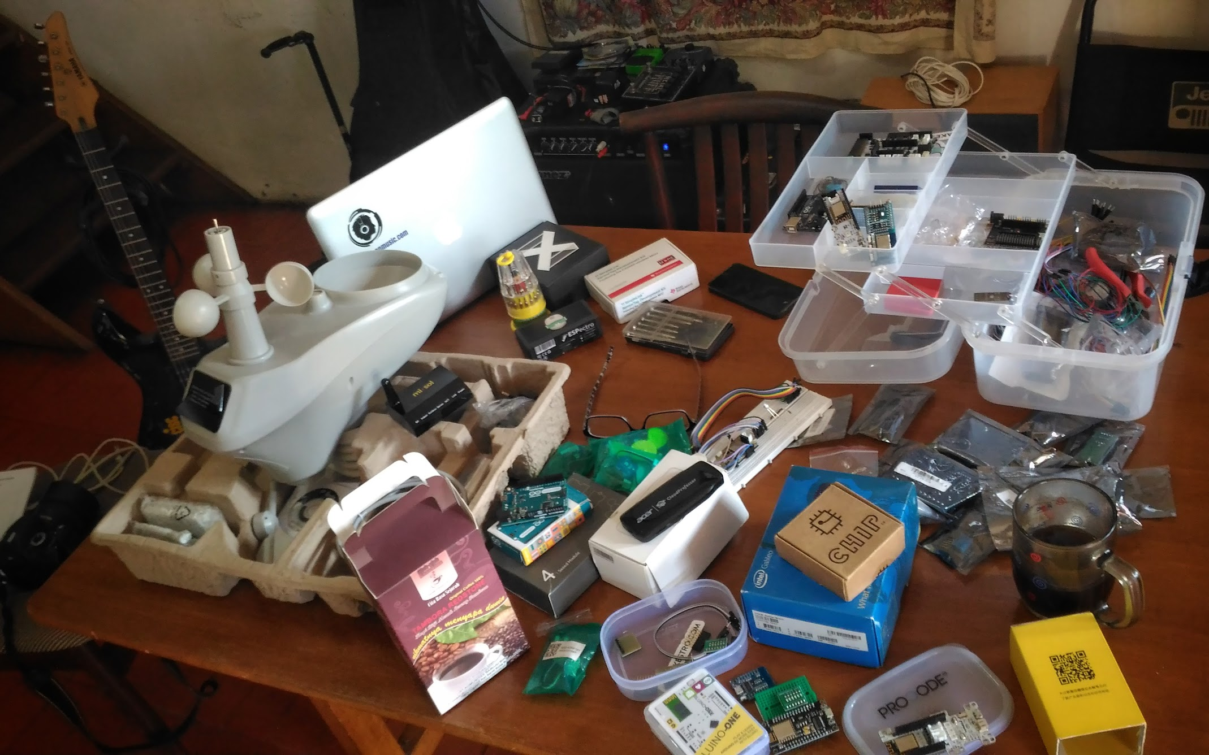
Internet of Things
There are two (2) keywords

Slide 6
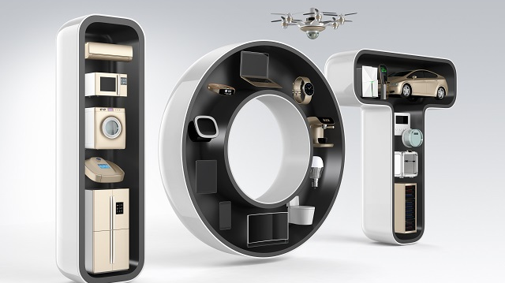
THINGS
THINGS
all kinds of things
all kinds of things

Slide 7
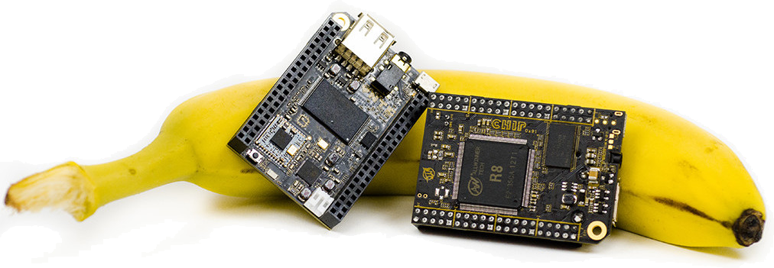
Possible because of hardware is getting smaller and cheaper
Dimungkinkan karena perkembangan teknologi komputer / hardware; membuat perangkat makin kecil dan makin murah

Slide 8
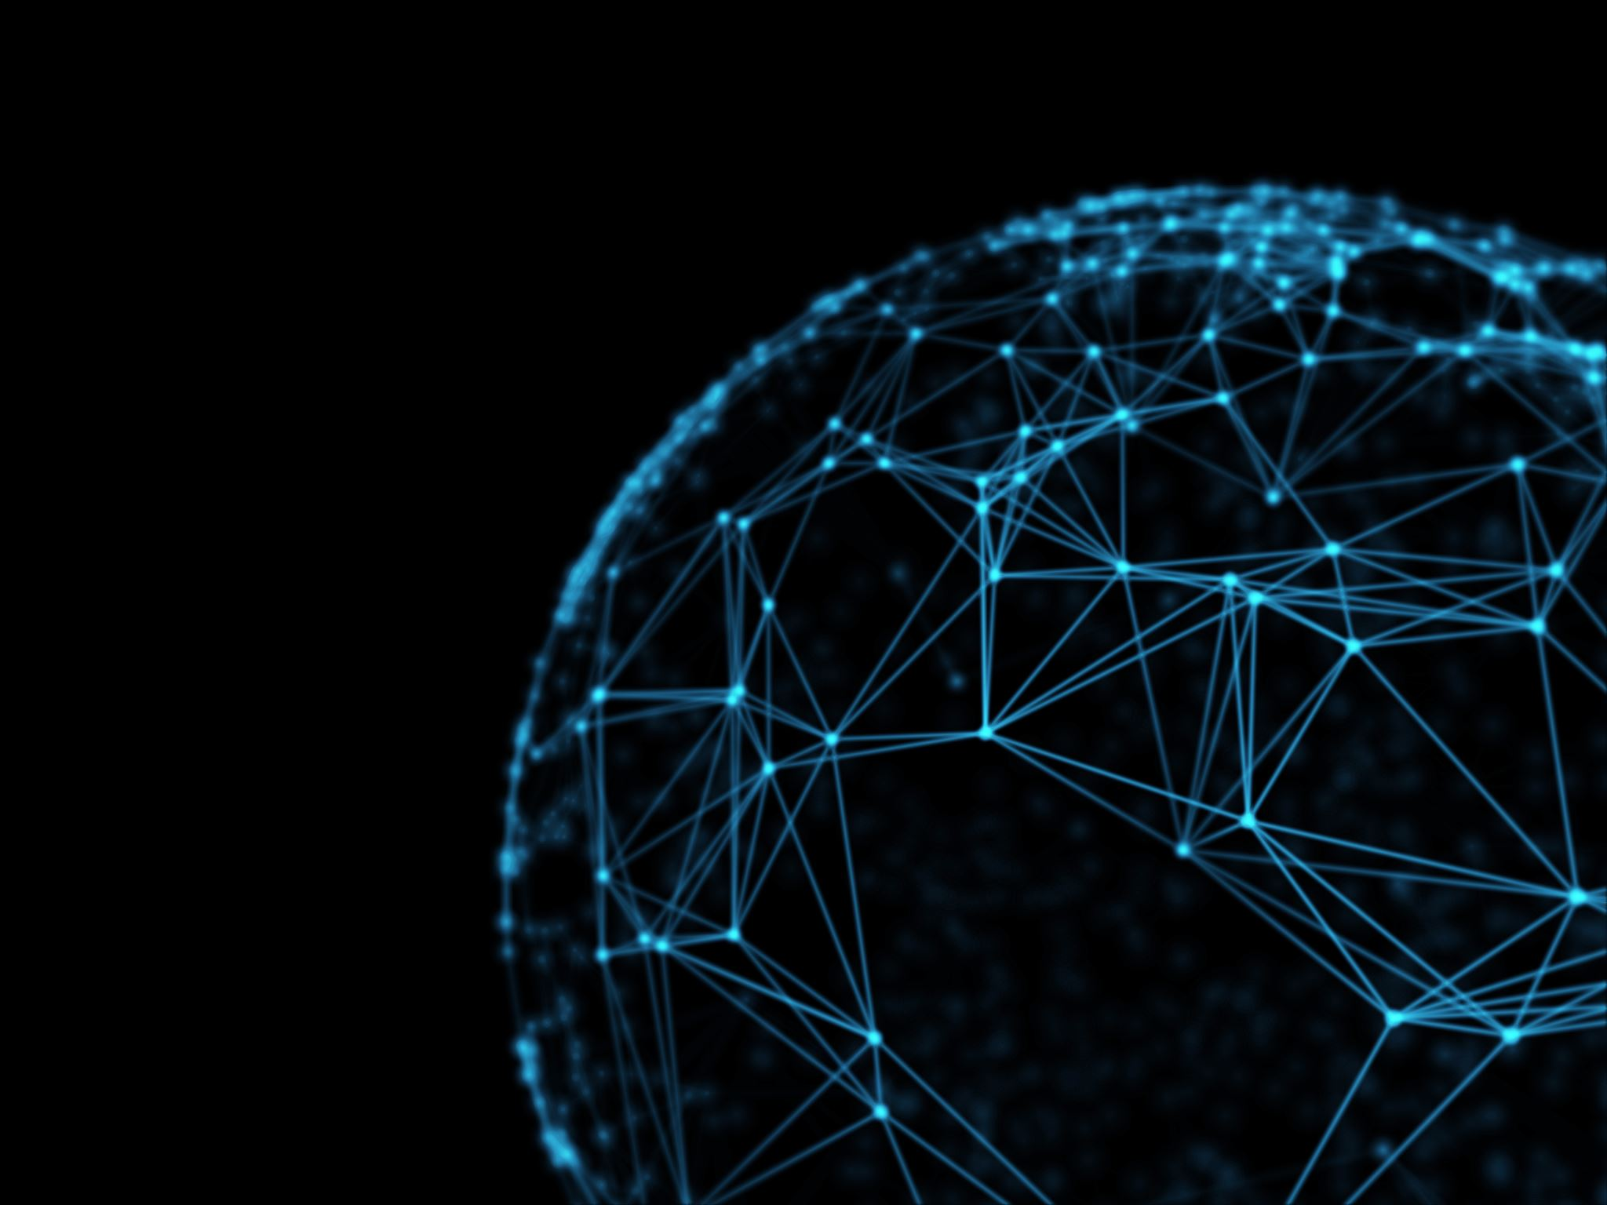
”Internet”
Connected to a network (usually the internet)
Terhubung ke jaringan (network) – biasanya internet
Coverage is getting better and cost is cheaper
WiFi, Bluetooth, LoRa, NBIoT, 5G, ... (6G ...)

Slide 9
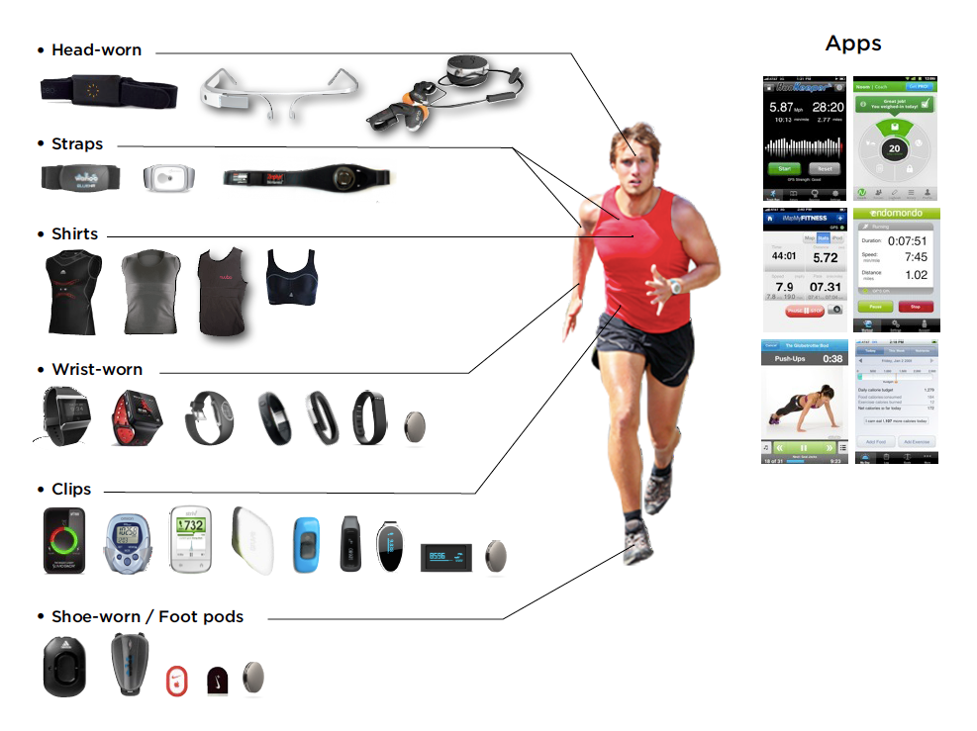
Example of IoT application

Slide 10
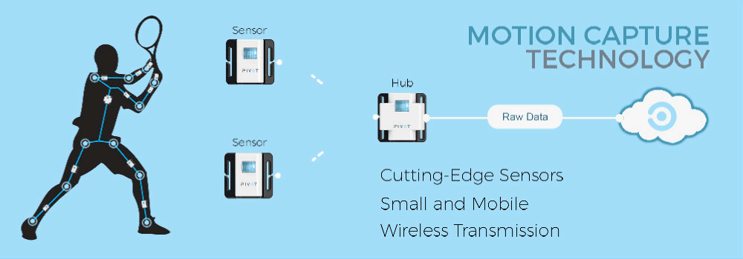
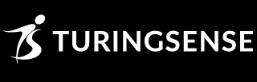
Pivot by Turing Sense

Slide 11
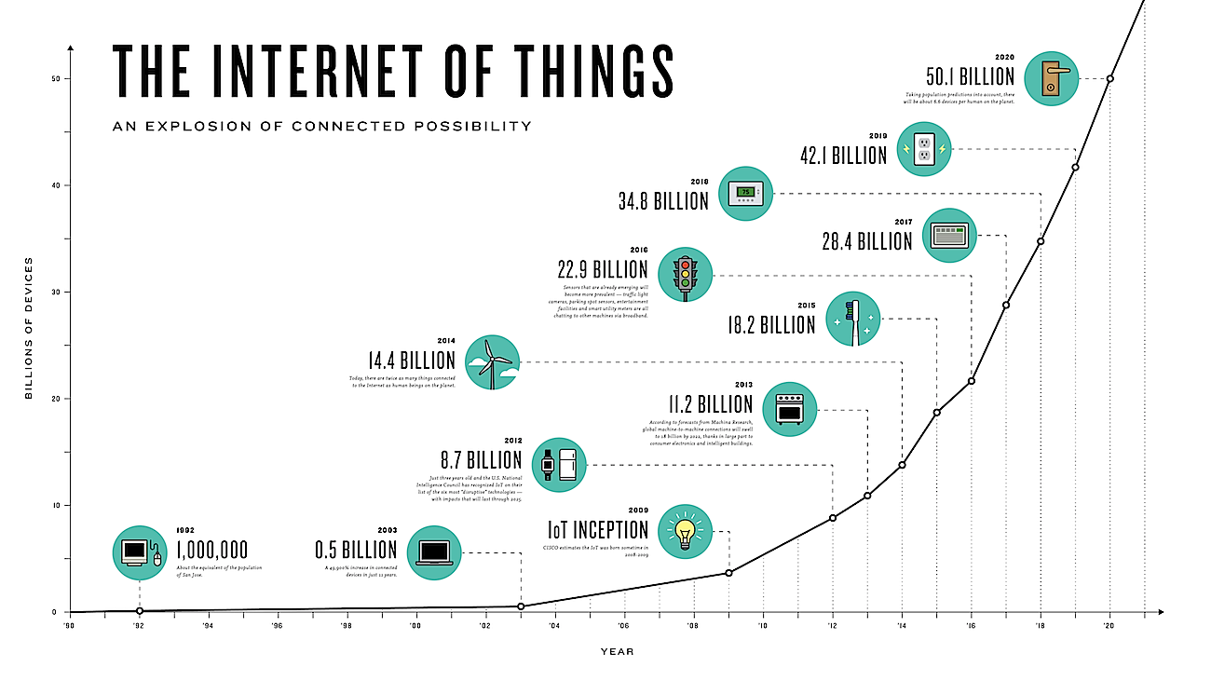

Slide 12
Why Exponential?
Computers
1 person, 1 computer
Handphone / mobile phone
1 person, 2 mobile phones (or more)
IoT
1 person, dozens of IoT devices

Slide 13
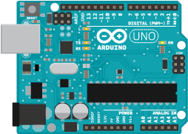

Arduino
Easy IoT development platform

Slide 14
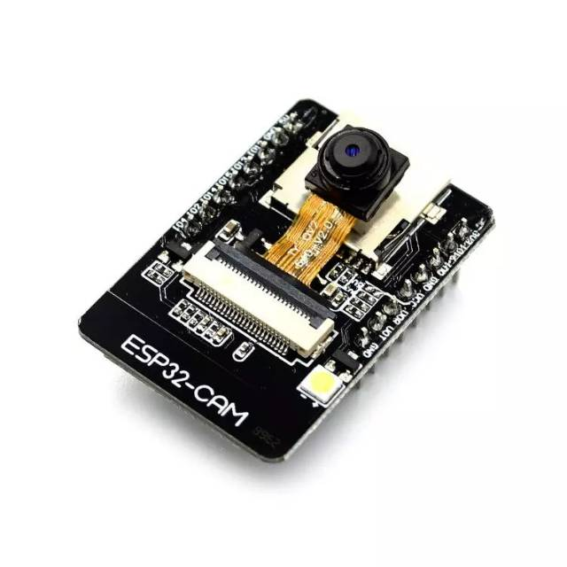
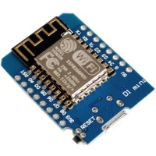
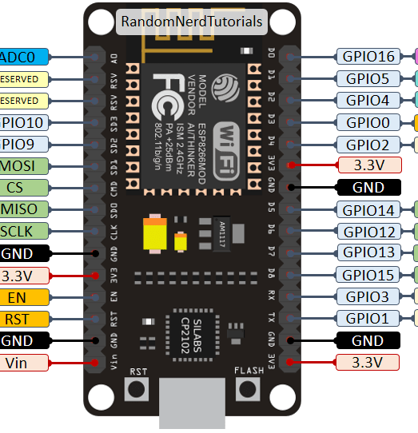

ESP8266, ESP32, ESP32 CAM, ...

Slide 15
Applications | Examples

Slide 16
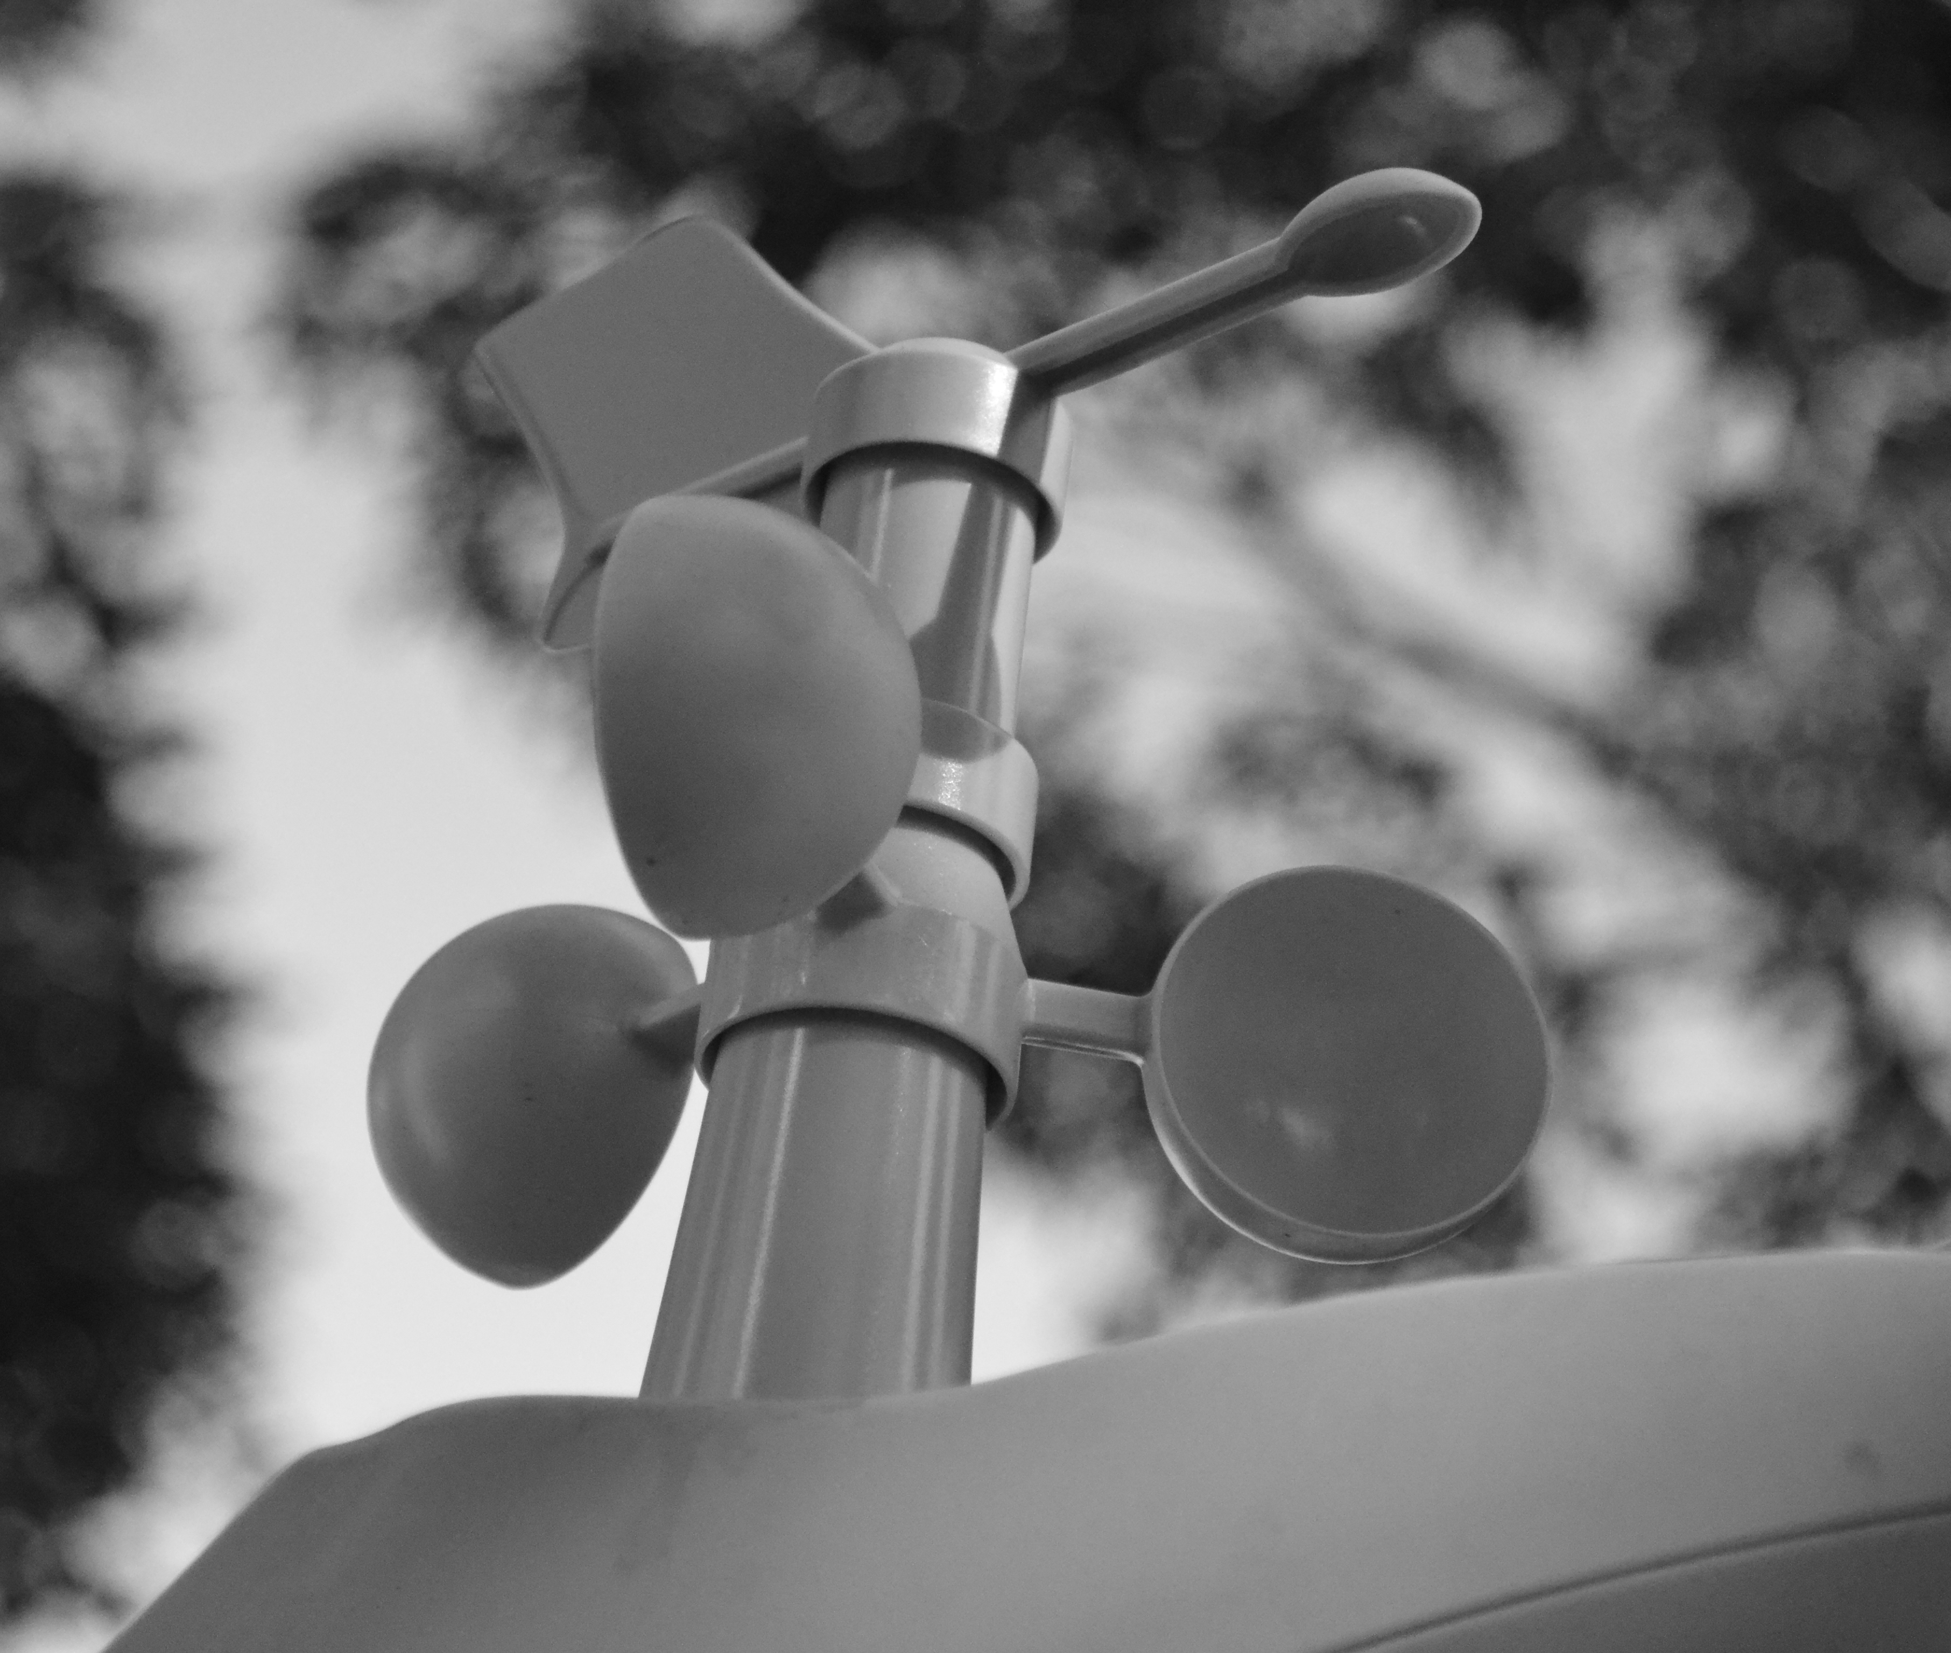
Bandung Weather Sensors

Slide 17
Tentang Bandung Weather Sensors
A collection of weather sensors installed in sub-districts offices in Bandung city
A collaboration project by Diskominfo Bandung, PT Fiber Star, PT INDO CISC
60 sensors have been installed out of 155 planned
Weather data is available through open API
Hackathon (application development) has been conducted

Slide 18
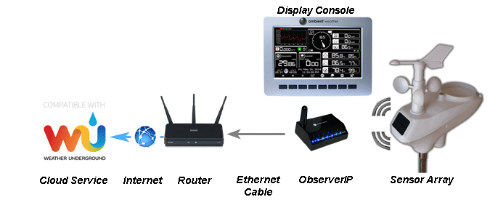
Configuration
weather.ID

Slide 19
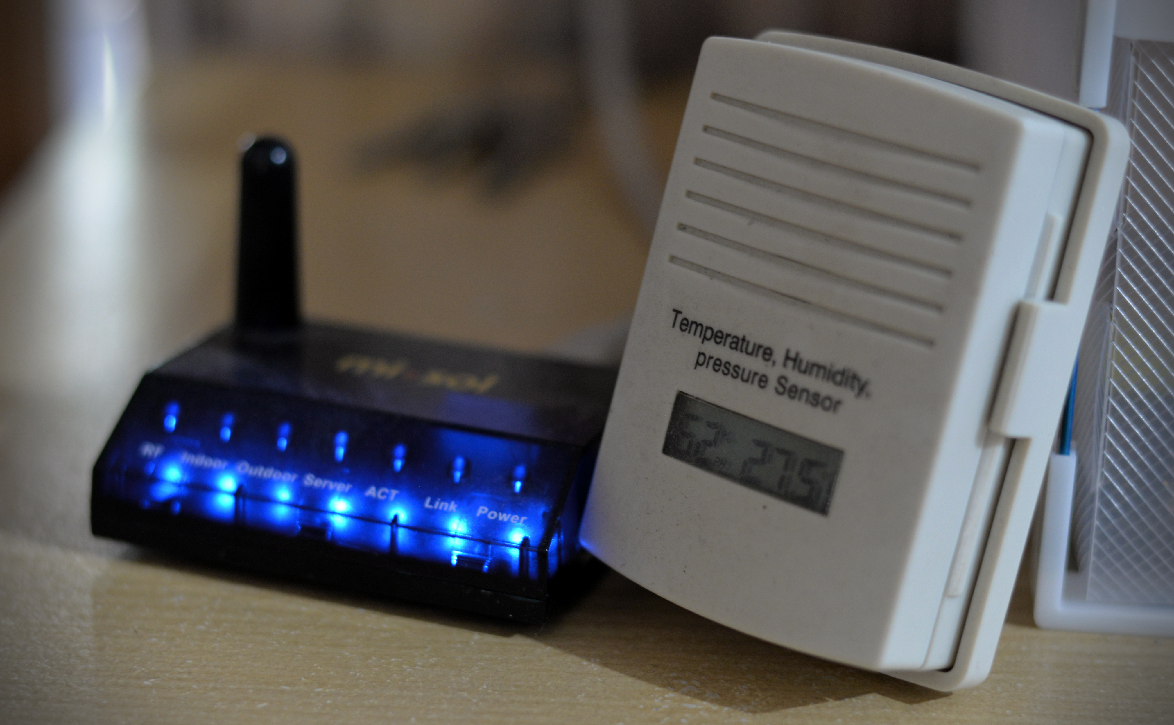
LoRa gateway
Additional sensors can be added. Here is an example of indoor temperature & humidity sensors

Slide 20
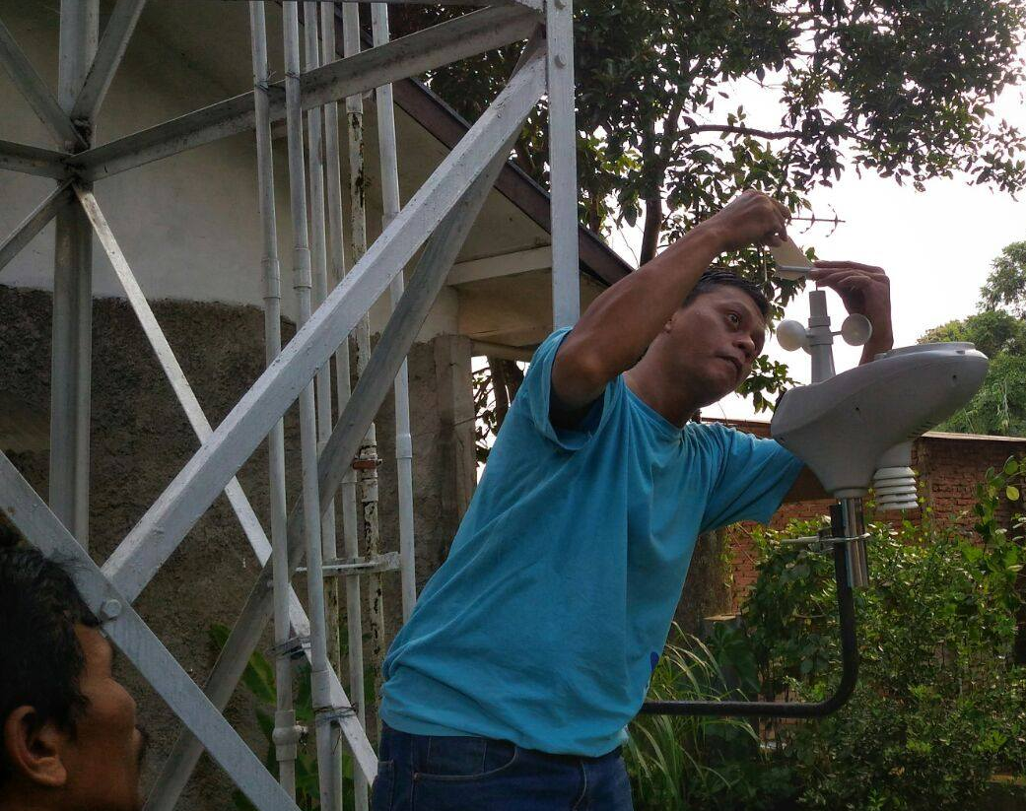
Installation

Slide 21
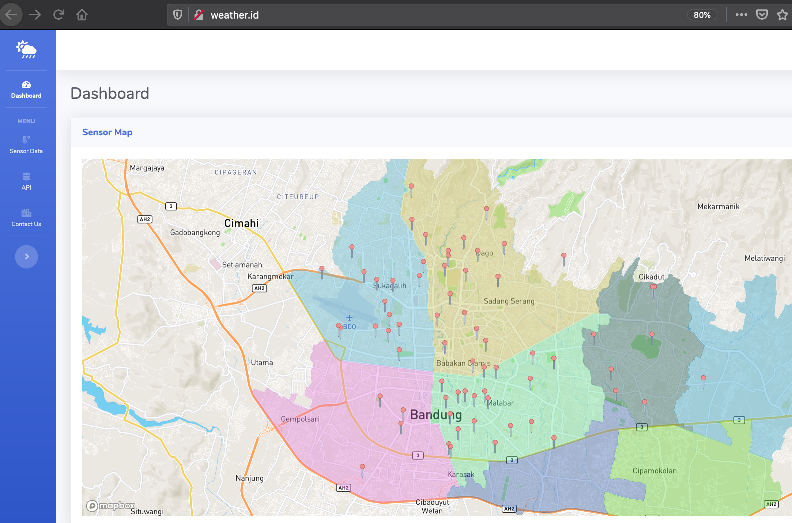

Slide 22
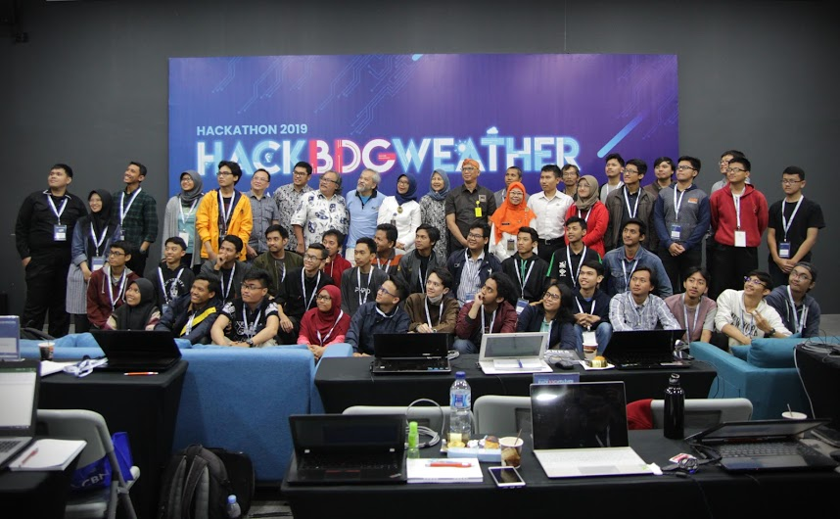





Hackathon #hackBDGweather

Slide 23

Weather data is need in agriculture-related applications as shown in the hackathon participants (eg. SeedPlan, the winner of the hackathon)
Mapping plant commodities
Marketplace
...

Slide 24
Contoh Aplikasi Lain (Sedang Dalam Pengembangan Secara Lokal)
Pemantauan lebah (bee sanctuary)
Pengamatan lingkungan untuk mendeteksi potensi hama
Memantau temperatur, kelembaban, suara
Toko tanpa penjaga (unmanned store)
Pendeteksi kondisi sungai
Deteksi banjir: Debit air, ketinggian
Kualitas air
Kesehatan (lifestyle)
Pemantauan lingkungan kandang ayam

Slide 25
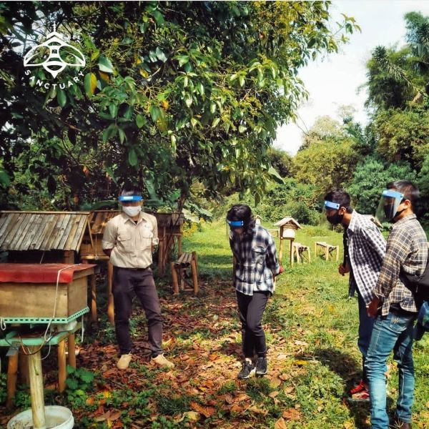
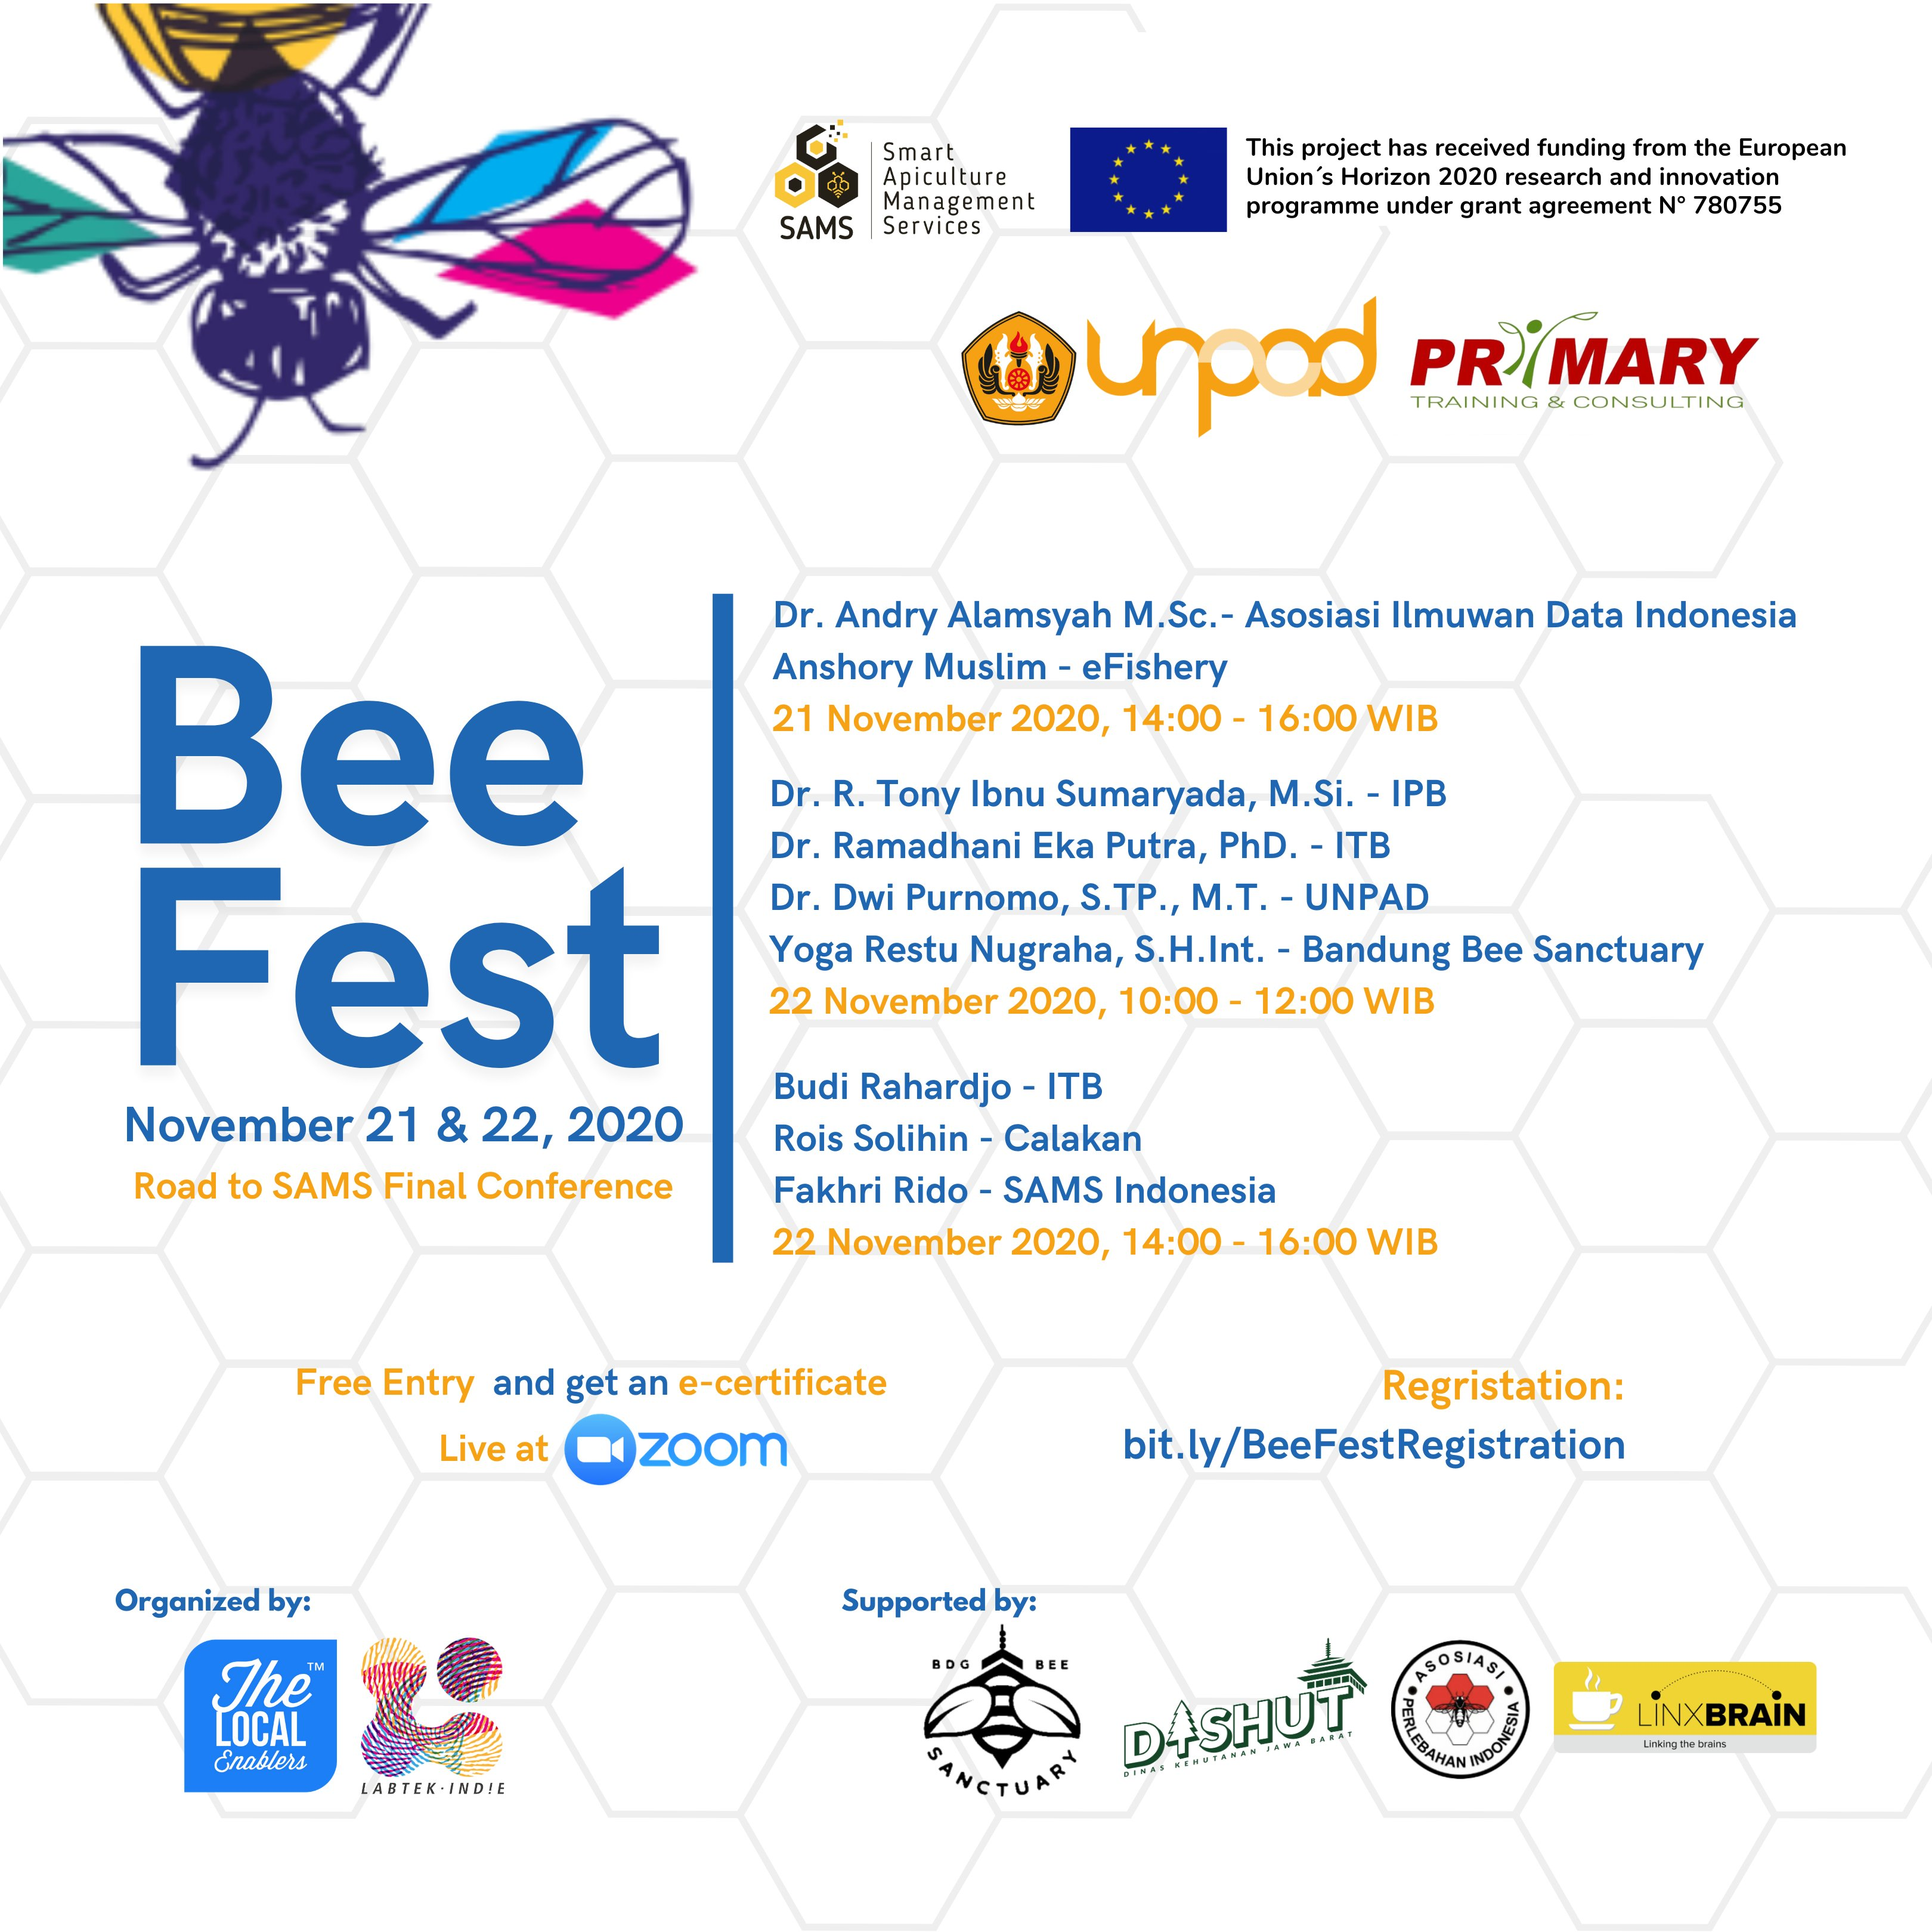

Slide 26
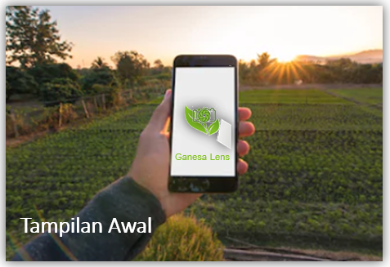
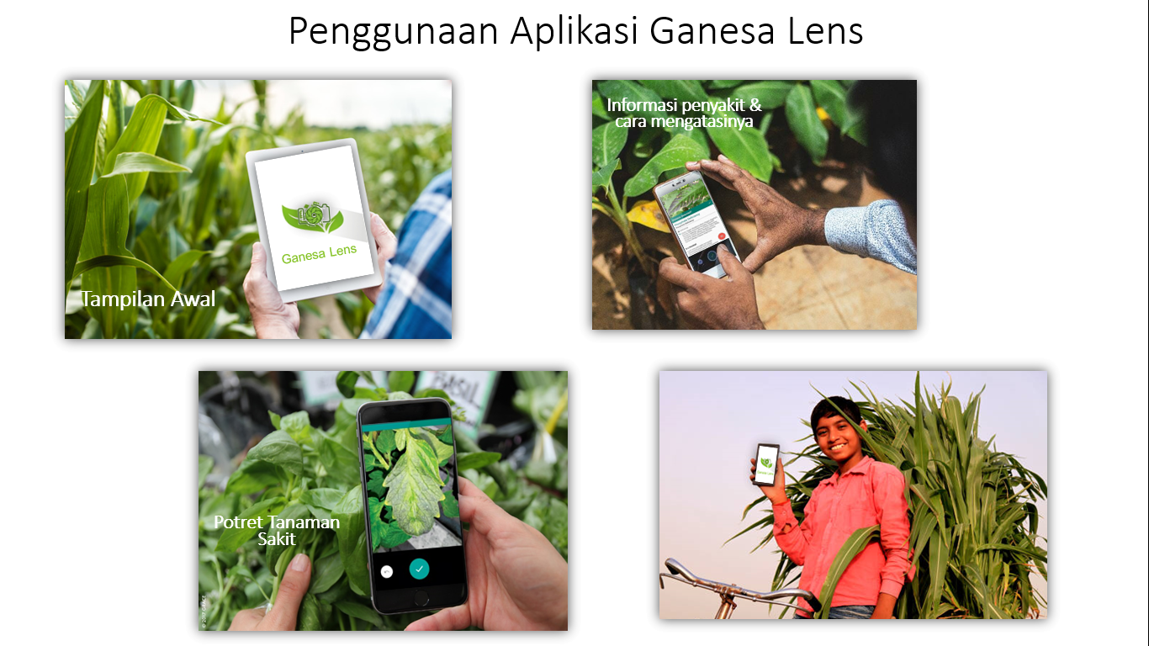



Hama Penyakit & Tanamanan Knowledge Management System + Mobile App: Ganesa Lens
SISTEM IoT DAN MOBILE APP BERBASIS AI UNTUK APLIKASI DISEASES SCREENING TANAMAN SAYURAN DALAM RANGKA MEWUJUDKAN PERTANIAN 4.0
“Generasi Petani Millennial menggunakan teknologi Pertanian 4.0”

Slide 27
Aplikasi-aplikasi lain
Berbagai sensor di pabrik (menggantikan sensor yang dikunci oleh pabrikan)
Mesin-mesin
Lingkungan (environment)
Pengelolaan gudang (contoh: Amazon, Alibaba)
Kesehatan (protokol COVID-19)
No touch

Slide 28
Other Opportunities: Hardware
Chip (processor) level
Processor, network processor
Board level
Development board, custom (special purpose)
System

Slide 29
Software
(Development) Platform
Current: common IDE (Arduino, PlatformIO, Kaa Project), local?
Killer Applications
Computer: spreadsheet
Mobile: SMS / chat / messaging
IoT: ???

Slide 30
Services
Queue – MQTT (next presentation)
The “search engine” of IoT
Google: search for documents generated by human
???: search engine for data generated by IoT
Not only search, understand meaning

Slide 31
Concluding Remarks
Internet of Things (IoT) is one of disruptive technologies
There will be many IoT applications, but the search for “killer applications” continues

Slide 32
Setup ARDUINO IDE
1. Open File -> Preferences
2. Option Additional Boards Manager URLs: paste the following link:
http://arduino.esp8266.com/stable/package_esp8266com_index.json
3. Go to Tools -> Board -> Boards Manager
4. Search ESP8266, install
ESP8266 by ESP8266 Community

